Slide 1
Why .NET Core
Lightweight
Modular
Cross platform
No machine wide installation
Run multiple versions in parallel
Faster (package based) release cycles

Slide 2
Framework choices
.NET framework | Mono | .NET Core
Machine wide | Machine wide | Per app
Existing code | Existing code | New code
Many types | Many types | Limited types
Windows only | Cross-platform | Cross-platform

Slide 3
.NET CLI
Command-line first approach
dotnet new
dotnet restore
dotnet run
dotnet build
dotnet publish

Slide 4
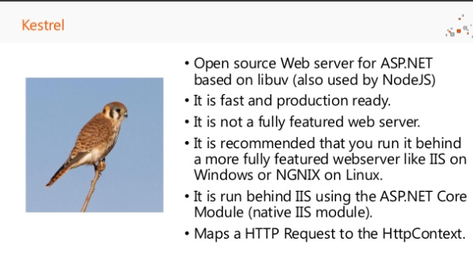

Slide 5
Introduction to ASP.NET Core
What is ASP.NET Core
When do we use ASP.NET Core as we have the legacy ASP.NET applications?
Why should I choose and use ASP.NET Core?
Why Microsoft Promoting Core and why taken the direction towards platform independence?
Important Features

Slide 6
Introduction to ASP.NET Core
Open Source : It is a free and open source framework used for developing ASP.NET applications.
ASP.NET Core is developed and powered by Microsoft as well as community user based.
It is a modular framework which has the capability to run on legacy .net framework which runs on windows as well as on cross-platform systems.
Originally it was called ASP.Net Next and later it was supposed to be named as ASP.NET 5 for release.
However Microsoft changed the name to ASP.NET Core 1.0 during its first release and it was released on 17th May 2016. Then later ASP.NET Core 2.0 released in 14th Aug 2017.

Slide 7
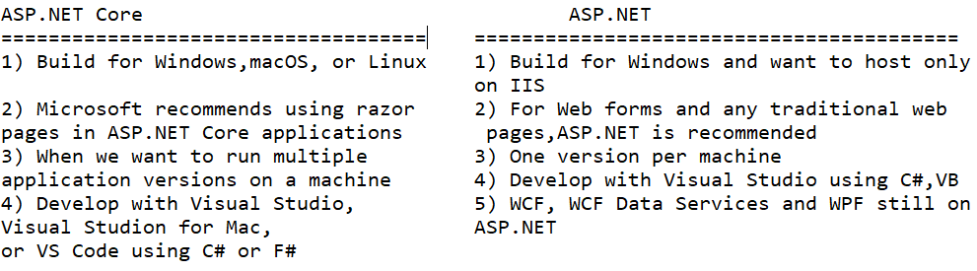
When do we use ASP.NET Core as we have the legacy ASP.NET applications?

Slide 8
Why should I choose and use ASP.NET Core?
Cloud based applications are picking up these days and using ASP.NET Core along with the blend of cloud is an additional advantage for any developer to learn ASP.NET Core
Also, Microsoft is moving towards community based development rather than their traditional application development which brings the changes faster to ASP.NET Core and gives advantages over ASP.NET development.
This gives rapid and easy changes in development life cycle.

Slide 9
Questions:
Why Microsoft Promoting Core?
Why taken the direction towards platform independence?
Why inclining towards MacOS and Linux community?
Why investing so towards attracting non-windows developers
Answers:
Developers don't stick to SQL Server development
There is high chance these applications end up somewhere on linux box or azure or in Amazon web services or on Google cloud platform.
So to enable the hosting of applications on these platforms, Microsoft is promoting the platform independence hosting along with the open-source community development
And this process gives Microsoft applications the bigger edge so that they can be developed using ASP.NET Core leveraging on Angular, React, Razor or any framework as well as Micro services which can be hosted on any platform.

Slide 10
Important Features
Improved support for cloud development
Gives greater facility with the Nuget based support.
Nuget based support gives easy updates on the packages and whenever newer version of the package is released it is easy to integrate or update the packages.
Gives bigger edge on development cycle as there is no need to upgrade the whole framework of the application.
Hence it is very imp features of the ASP.NET Core.
Modular framework:- ASP.NET Core ships entirely as Nuget packages which improves security and performance of the solutions and reduces servicing

Slide 11
Important Features
Cross platform compatibility
Flexibility of being open source
Hosting independence
Built-in support for dependency injection
Support for JSON based configuration

Slide 12
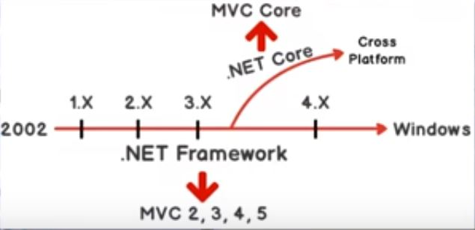
.NET Framework and MVC Core

Slide 13
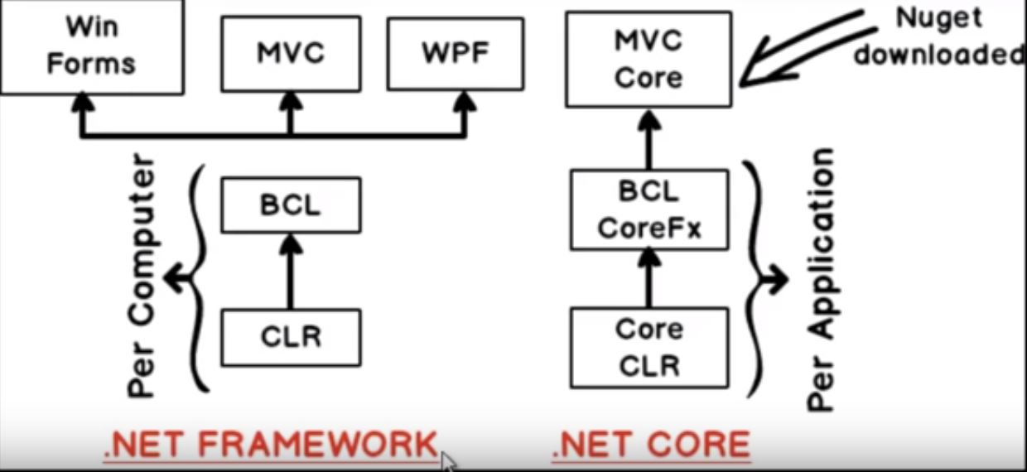
.NET Framework and MVC Core

Slide 14
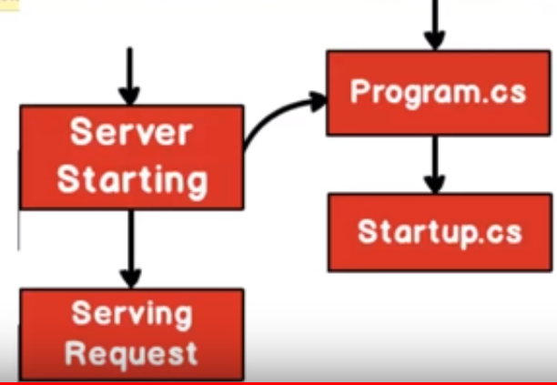
Flow of Execution

Slide 15
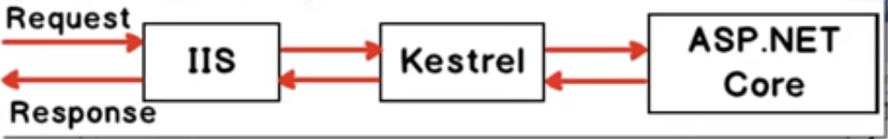
IIS and Kestrel

Slide 16
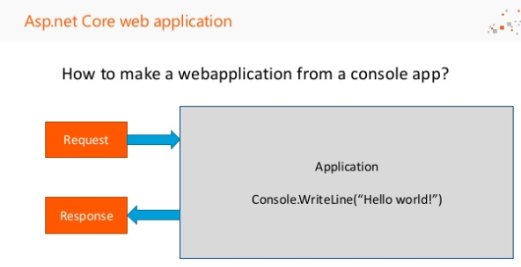

Slide 17
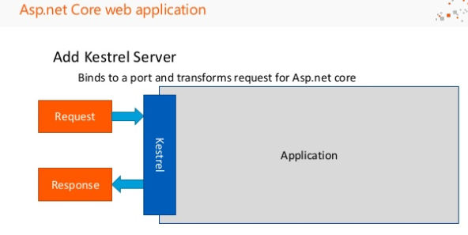

Slide 18
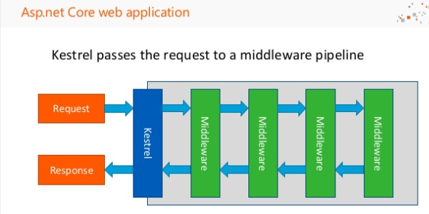

Slide 19
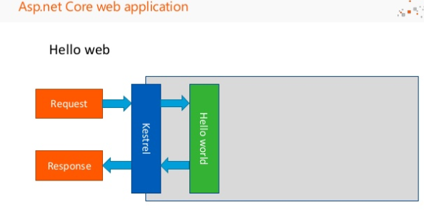

Slide 20
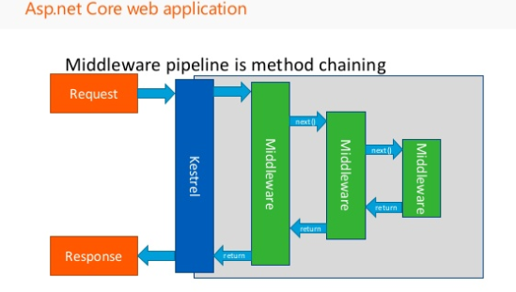

Slide 21
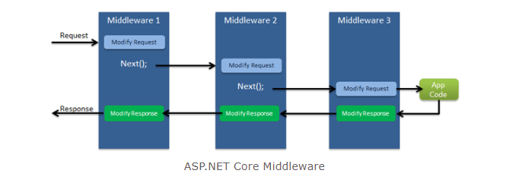
ASP.NET Core - Middleware

Slide 22
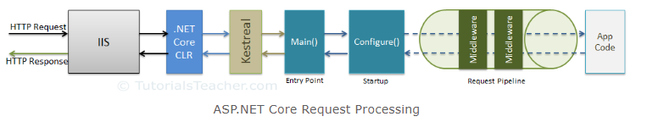
ASP.NET Core - Middleware

Slide 23
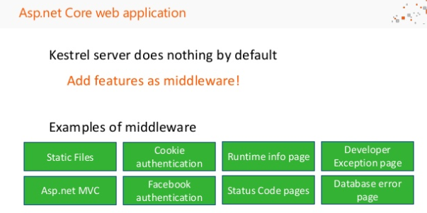

Slide 24
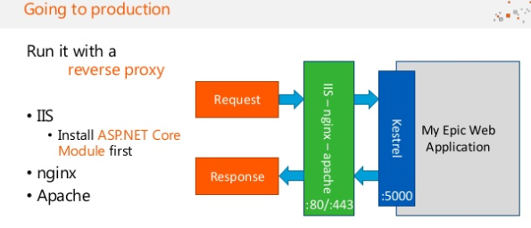

Slide 25
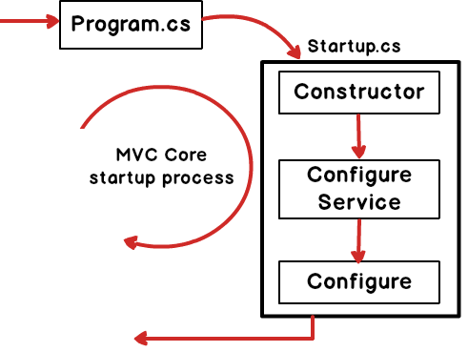
Need of Program.cs and startup.cs file

Slide 26
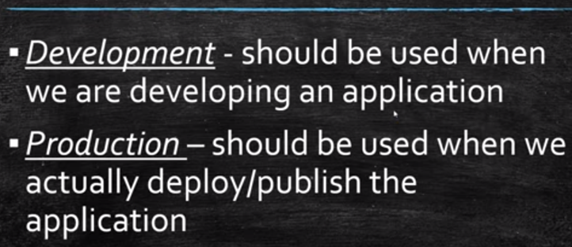
Development and Production

Slide 27
Development and Production
IsDevelopment() & IsProduction()
In which environment is the app running?
What happens when we are in production?

Slide 28
Entity Framework Core*
The Future of EF for ASP.NET Core

Slide 29
DB-Driven Web Applications
Web App
Internet
ORM
Database
Users

Slide 30
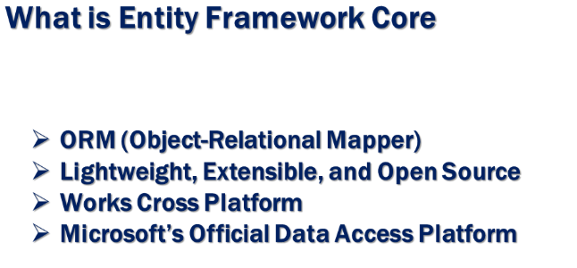

Slide 31
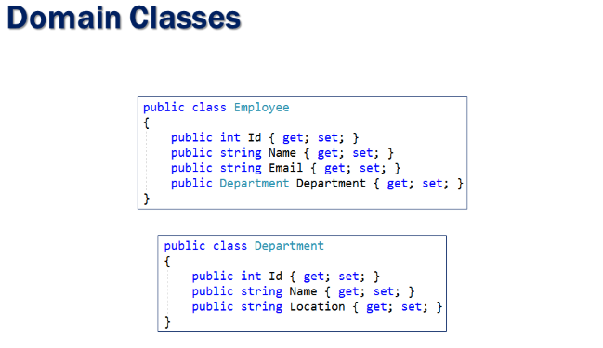

Slide 32
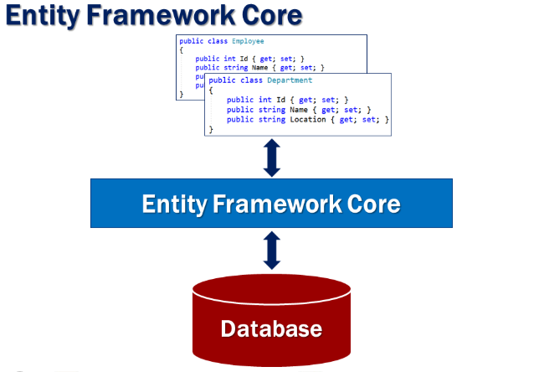

Slide 33
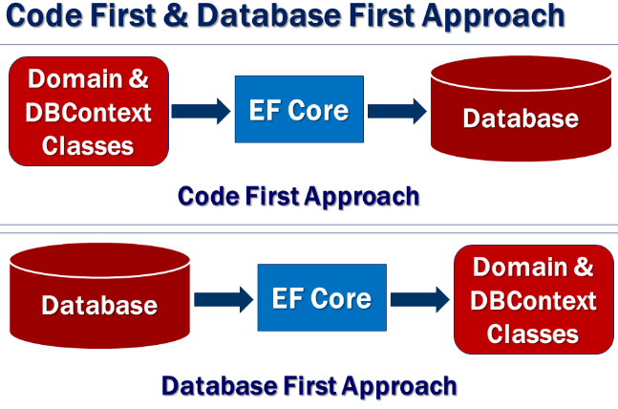

Slide 34
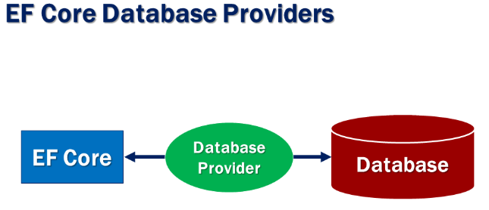

Slide 35
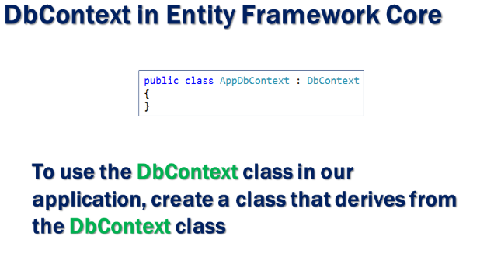

Slide 36
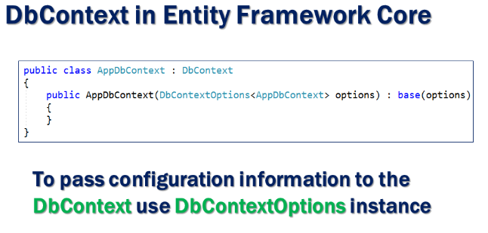

Slide 37
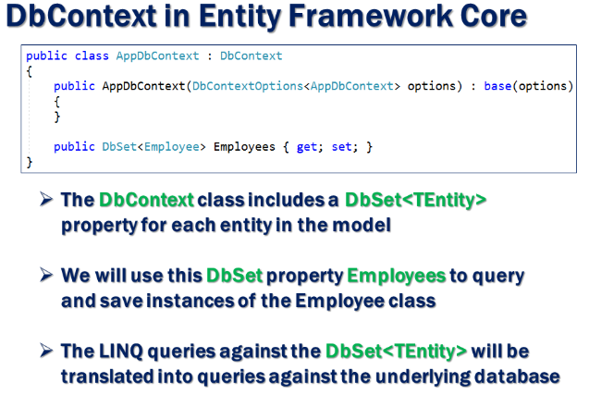

Slide 38
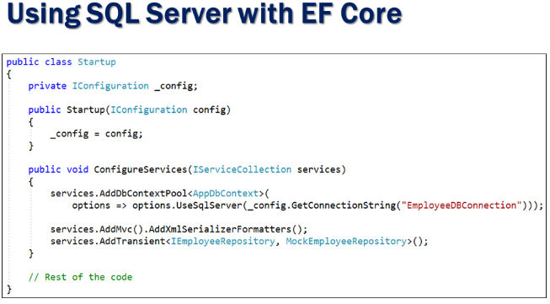

Slide 39
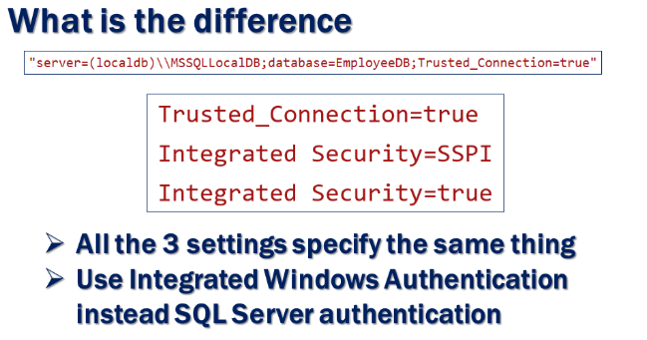

Slide 40
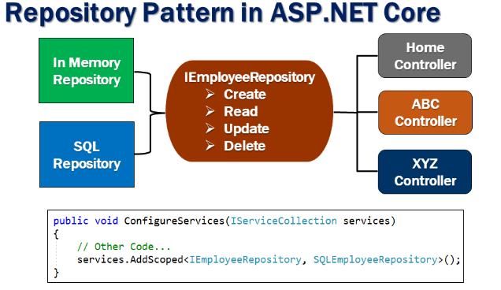

Slide 41
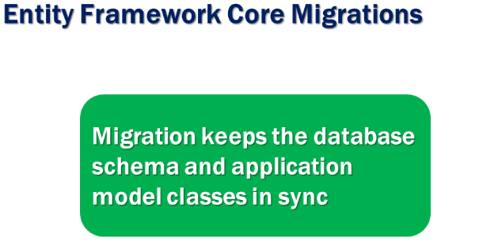

Slide 42
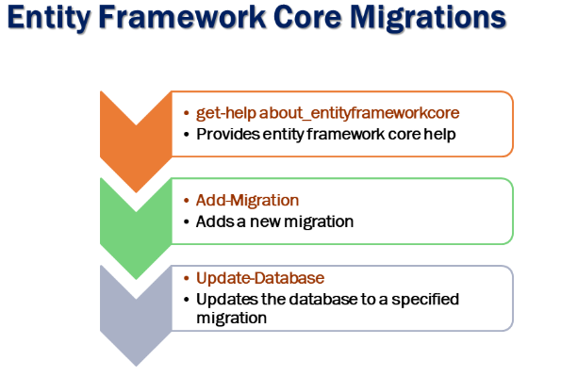

Slide 43
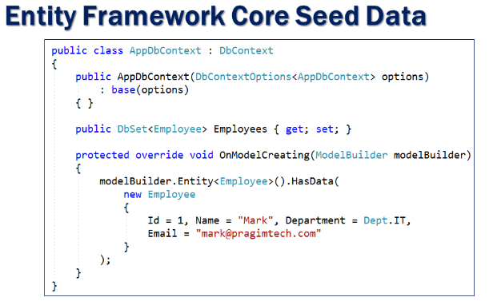

Slide 44
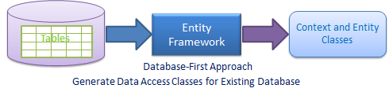
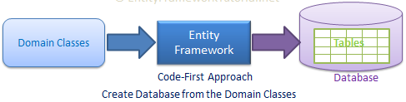
EF Core Development Approaches

Slide 45
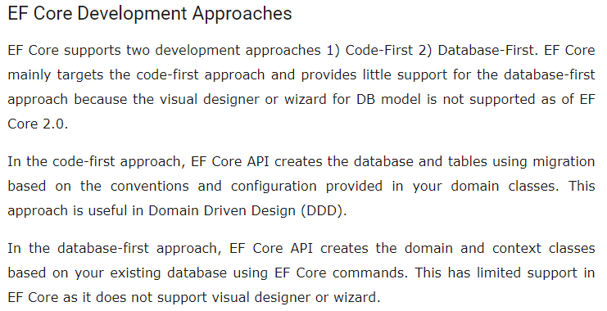

Slide 46
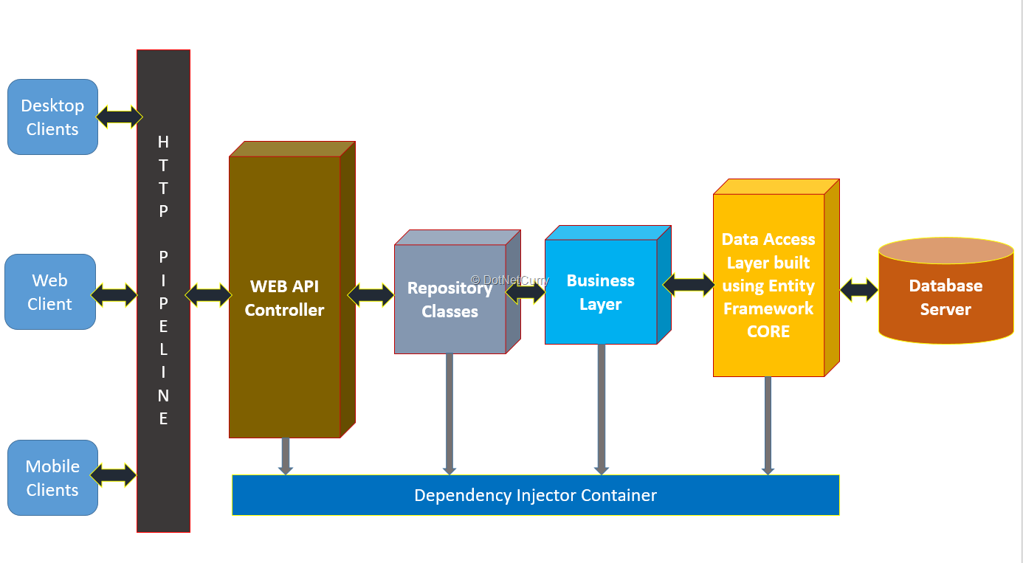

Slide 47
Configuring the Application

Slide 48
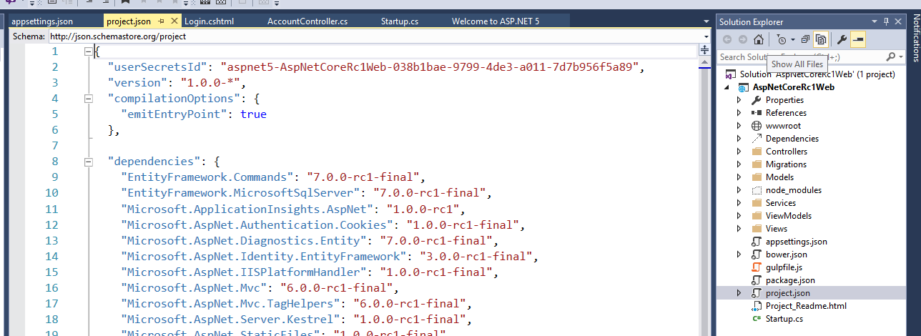
Project Files and Configuration

Slide 49
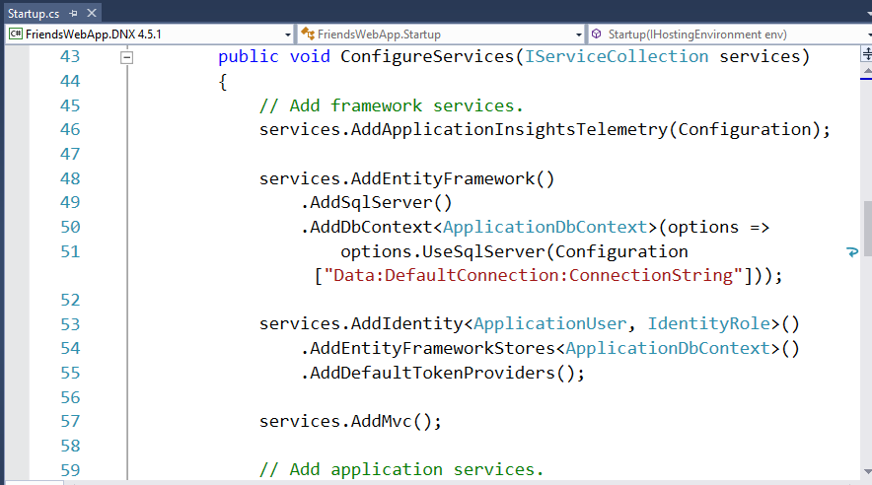
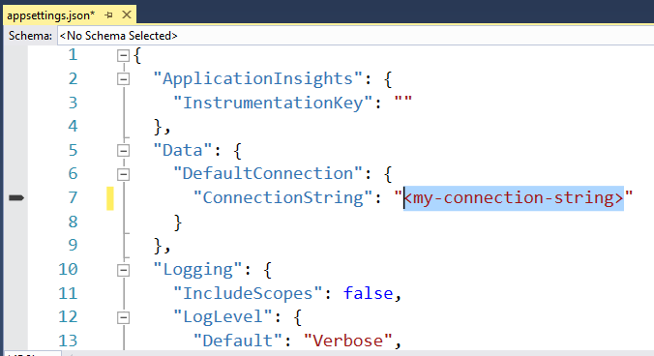
Connection Strings

Slide 50
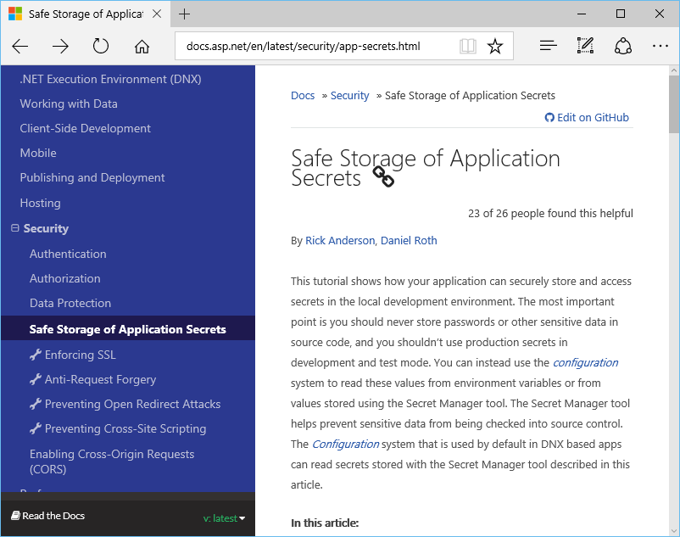
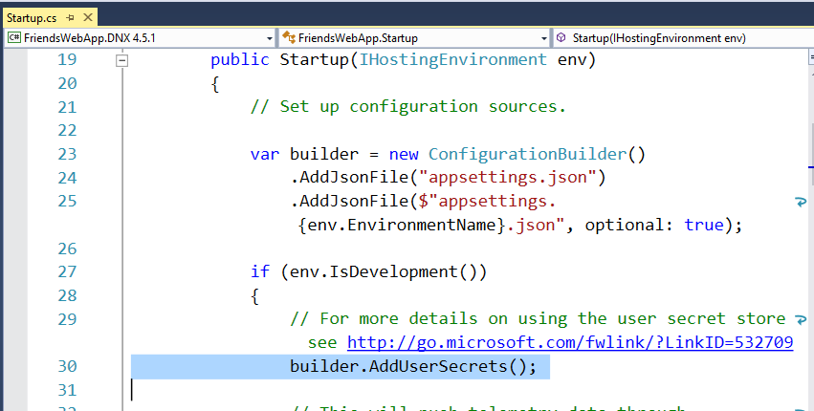
Connection Strings in Development

Slide 51
MVC
ASP.NET MVC Overview

Slide 52
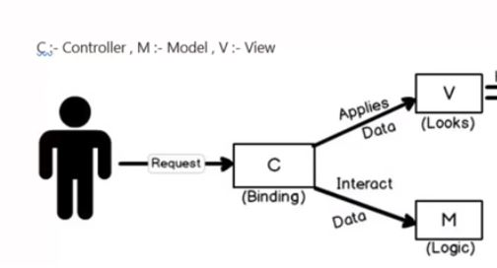
MVC Architecture

Slide 53
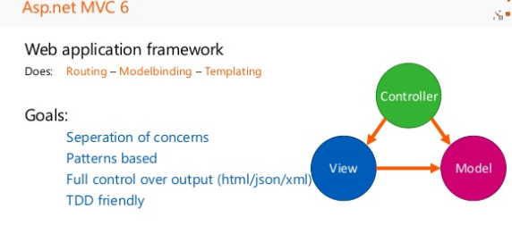

Slide 54
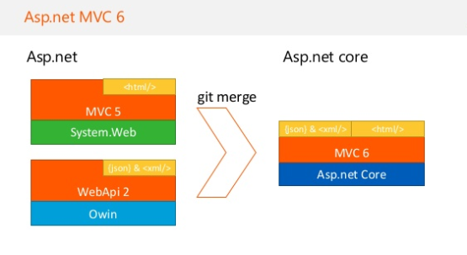

Slide 55
APPLICATION STRUCTURE

Slide 56
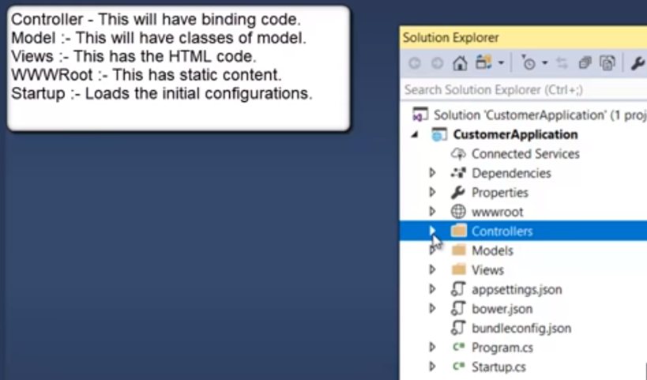
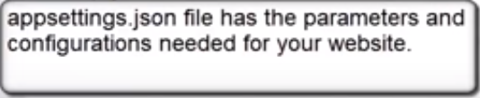

Application Structure

